Slide 1
Drug Development and Discovery
History of Clinical Trials

Slide 2
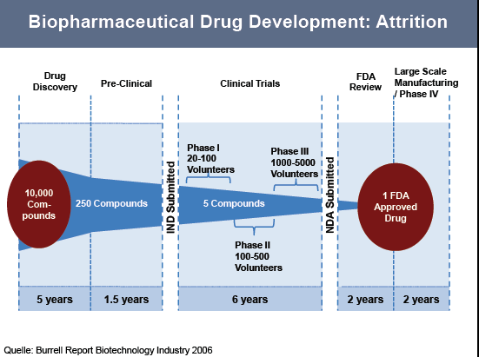

Slide 3
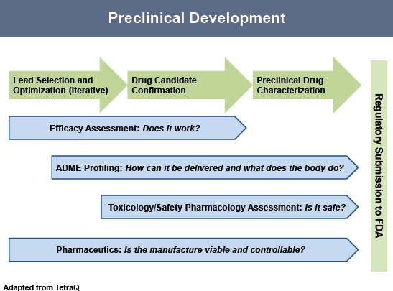

Slide 4
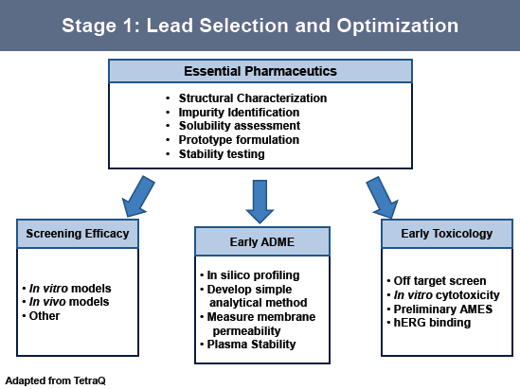
The Ames test is a widely employed method that uses bacteria to test whether a given chemical can cause mutations in the DNA of the test organism
hERG (pottasium channel), Torsades de Pointes : cardiotoxicity
Torsades de pointes : specific form of polymorphic ventricular tachycardia in patients with a long QT interval.

Slide 5
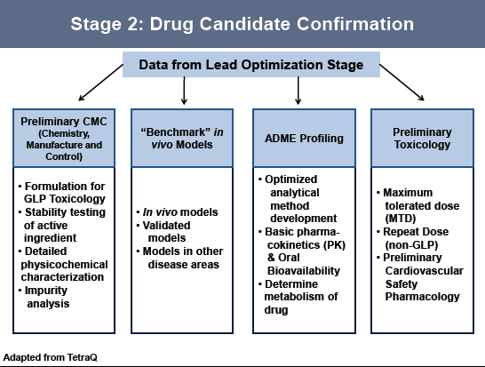

Slide 6
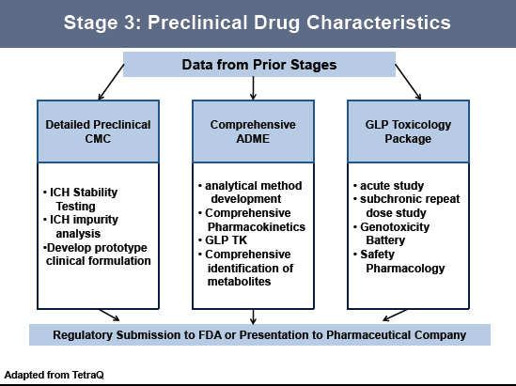
TK : Toxicokinetics

Slide 7
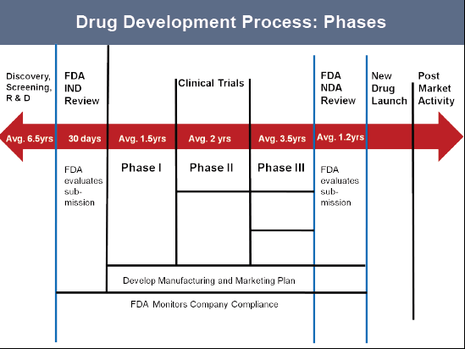

Slide 8
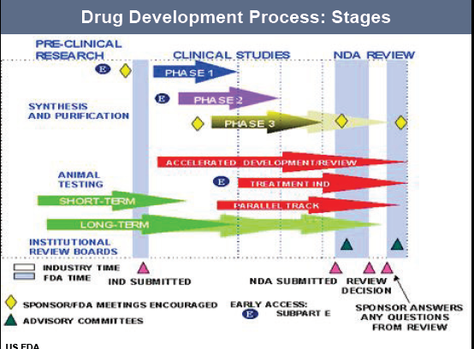

Slide 9
1st recorded clinical research
eighteen century. (1747)
Scurvy : tolled the life of British sailors
A number of common treatments, including cider, elixir of vitrol, vinegar, leaf past and sea water were in use to treat scurvy at that time.
In 1740 James Lind, a surgeon in the Royal Navy of Salisbury
designed a study (20th May 1747)
Chose 12 sailors and divided into six groups.
Five groups received exiting treatments and
sixth group who received two orange and a lemon each day.
Within a week, sailors of group sixth were nearly healthy again, while the health of the other subjects had declined significantly.

Slide 10
International Clinical Trial Day
20th May
Cause
James Lind’s controlled trial began on that day in 1747

Slide 11
20th century : experiments were done by Nazi doctors
Experiment 1: Prisoners were put in to low pressure tank to see how long they could survive with little oxygen. Many of them died.
Experiment 2: High altitude experiments: Prisoners were kept hanging to see how long they could survive in high altitude. Many of them died and then autopsied. Those who did not die immediately were put under water until they died and autopsy followed.

Slide 12
Experiment 3: Cold experiment: Prisoners were forced to remain outdoor during winter of -20 temperature without cloth for 9 to 14 hours or force to remain in a bath of freezing water till death to see how long a man can bear cold or what are the consequences of cold till death.
Experiment 6: Malaria Experimentation: Dr Klaus Karl Schilling, an eminent malaria expert, infected more than 1000 prisoners with malaria at Dachau and treated with his experimental anti-malarial drug.
More than 400 died from complications of treatment with experimental malaria drugs.

Slide 13
Experiment 7: Twins experiment: where, one baby was exposed to a pathogen and killed and then autopsied to determine the natural progression of disease. The other control twin was then sacrificed to see what the differences were. It may constitute a very interesting comparison for a scientific perspective but such an experiment was not only unethical but inhuman.
Experiment 9: Hundred of prisoners were killed for accumulation of skeleton for anthropological investigation. Those killed were considered prototype of what the Nazi called characteristic subhuman.
Experiment 10: To create a genetically pure population (eugenics) the “Law for the Prevention of Genetically Diseased Descendants” was passed and sterilization was enforced. Within four years, 3,00,000 people had been sterilized.

Slide 14
Nuremberg Code. In December 1946
following world war II, America military tribunal opened criminal proceedings against 23 German physician and administrator for their willing participation of cruelty against humanity in the name of research.
Nuremberg Code has 10 basic principal of moral, ethical and legal concept
1. Voluntary consent is essential. German physicians conducted medical experiments on thousands of prisoners of concentration camp without their consent. Most of the subjects of these experiments died or were crippled permanently.

Slide 15
2. Research must benefit to the society. It is unethical to needless endanger the well being of human volunteers if other methods of investigation exist.
3. Research must be based on preclinical study on animal.
4. Avoidance of all unnecessary physical and mental suffering and injury.
5. Avoidance of the death and disability.
6. Subjects must have the right to end their participation in research.

Slide 16
7. Preparedness and adequate facilities should ensure to protect the subjects against even remote possibility of injury, disability and death.
8. Preparedness for termination of experiment at any stage of research if continuation of experiment is likely to result in injury, disability or death of subjects.
9. Experiment should be conducted only by scientifically qualified persons.
10. Research risk must be minimized and relative to the anticipated benefit of research.

Slide 17
1962, Food, Drug and Cosmetic Act
Before mid ninetieth, US government had no control over manufacturing and dispensing of drug.
In the late 50s, thalidomide was sold as a sedative to control sleep and nausea through out pregnancy in Europe.
But it was found that taking this drug during pregnancy caused sever deformities in the baby. (Phocomelia)
Many patients did not know that they are taking a drug that was not approved by FDA nor did they gave informed consent.
Some 12,000 babies were born with sever deformities.
In 1962, Food, Drug and Cosmetic Act was passed into law to ensure drug efficacy and greater drug safety.
Under this law, for 1st time drug manufacturers were required to take endorsement from FDA for the effectiveness of their products before marketing.

Slide 18
1964 :Helsinki declaration
In 1964, the World Medical Association established & recommended the guidelines for medical doctors in biomedical research involving human, that is known as Helsinki declaration.
The declaration delaminate the therapeutic research from non-therapeutic research.
Issues addressed in the declaration are includes

Slide 19
1. Delaminate practices from research
2. Research protocol should be reviewed by an independent committee (IRB, ERB etc) prior to initiation.
3. Informed consent is necessary
4. Risk should not exceed from benefit.
5. Allow subject representative to consent who cannot consent but willing to take part in research.
6. Research with human should be based on the results from laboratory and animal experimentation.
7. Well being of subjects should take precedence over the interest of science and society.

Slide 20
Helsinki Declaration was revised in 1975, 1983, 1996, 2000 and it is the basis for Good clinical practices used today.

Slide 21
Tuskegee Syphilis Study (1932-1972).
The most unethical research in history was Tuskegee Syphilis Study (1932-1972).
A research was conducted in Tuskegee, Alabama, USA in 1932 on 600 low income African American male. 400 of who were infected with syphilis and 200 were considered as control and monitored for 40 years to asses the natural history of syphilis.
Subjects were not told about the disease and denied any treatment even though a proven cure (penicillin) was publicly available in the 1940s.
There was no scientific rationale for this study because the natural history of syphilis had already been elicited.
Many subjects died of syphilis during the study.
The study was stopped in 1972 by the US department of health education and welfare only after existence of this research was publicized in media.

Slide 22
It became a political embarrassment. But by the time 74 of the subjects were still alive, Of 40 wives had contracted syphilis, 19 babies were born with congenital syphilis.
In 1970, compensations were given for the
survival and for the families of those who died from this study .
1997, under mounting pressures; President Clinton apologized to the study subjects and their families and granted $ 200,000 for creation of Tuskegee University National Center for Bioethics in Research and Health.

Slide 23
The Clilnic Drug Development Process
Each country has a drug regulatory body which governs the approval process
India- CDSCO (central drugs standards and control organization)
US- FDA (food and drug administration)
UK- MHRA (medical and healthcare products regulatory agency)
European Union- EMEA (european medicines agency)
Drug must be proved to be safe and effective

